Slide 1
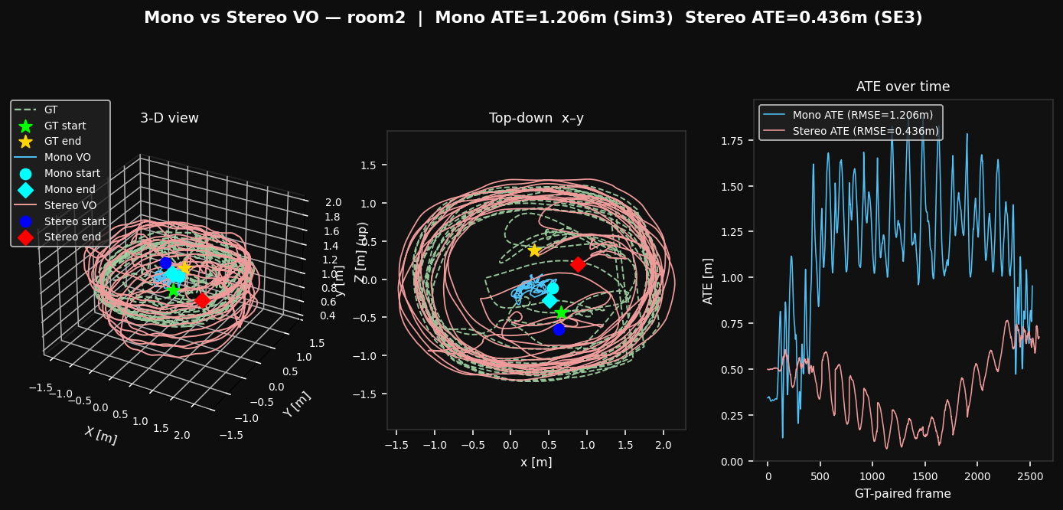
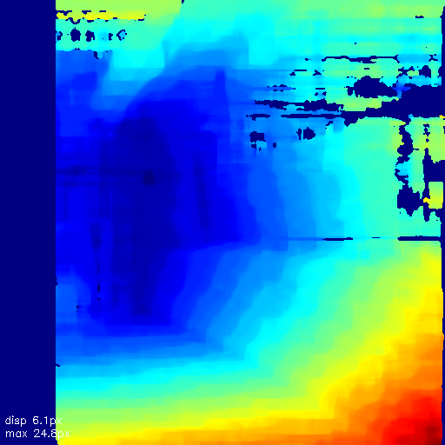
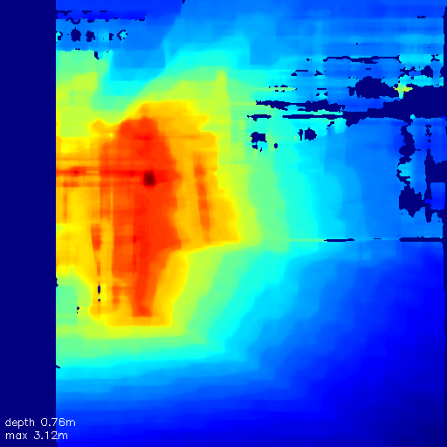
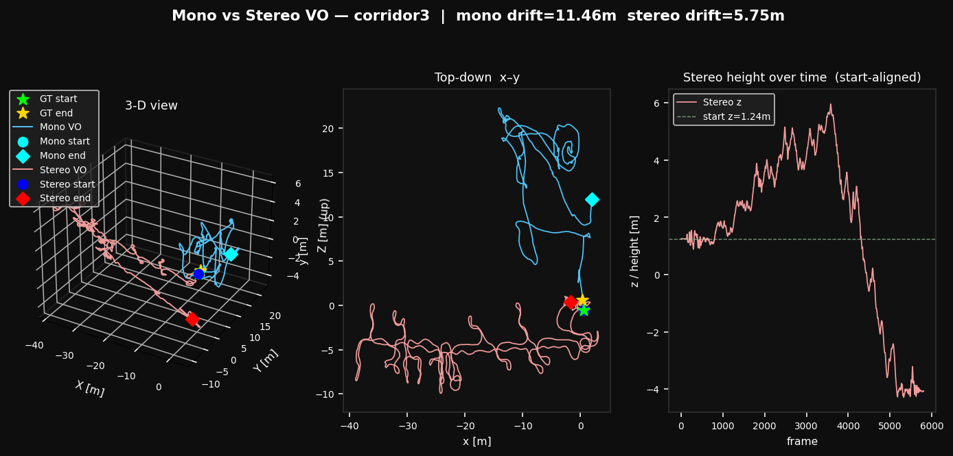
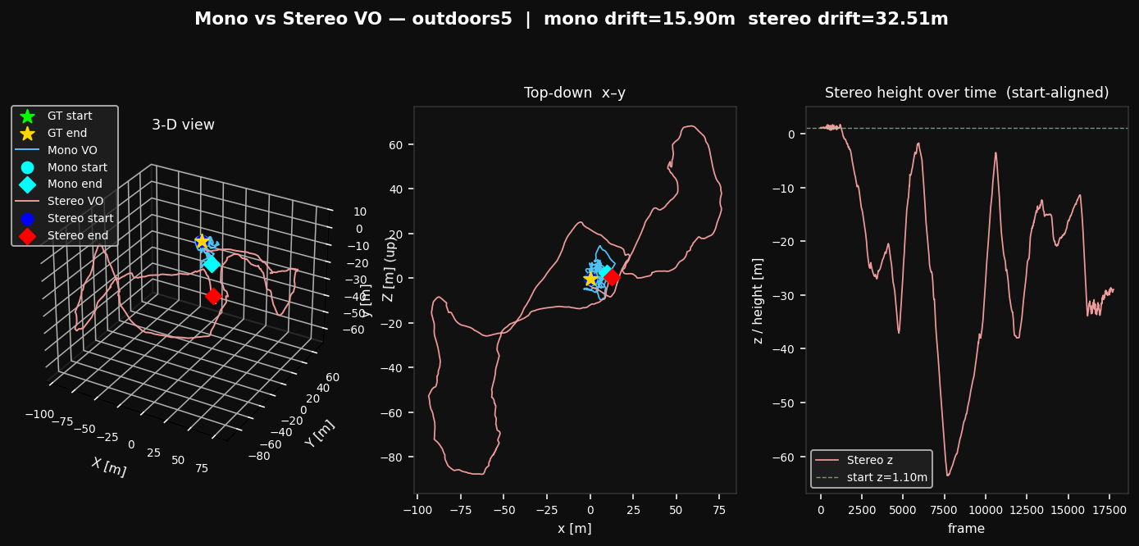
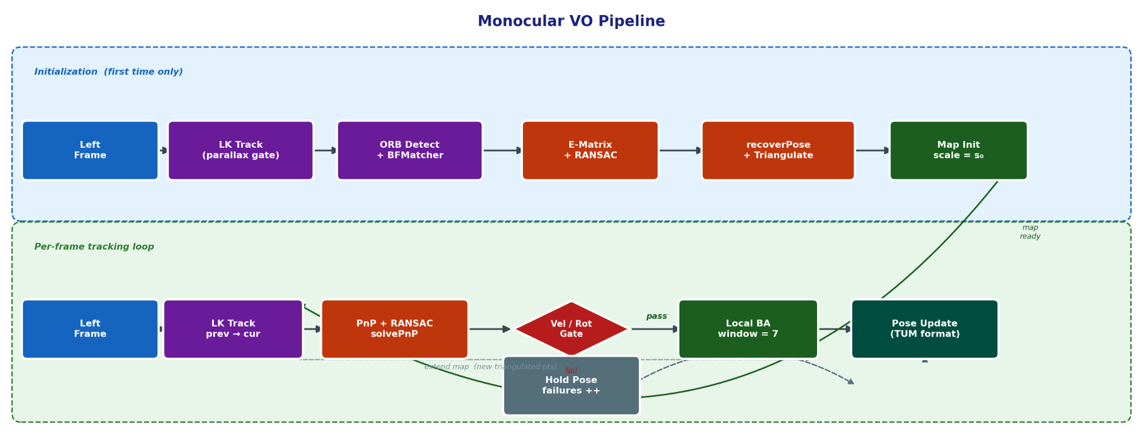
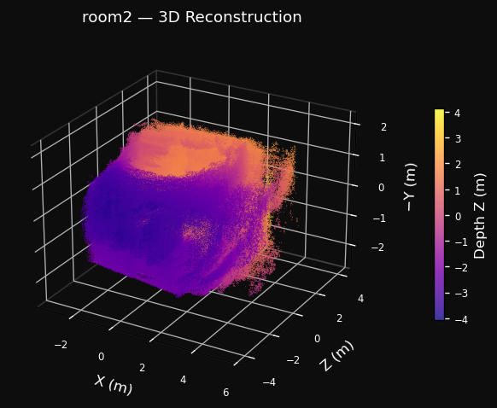
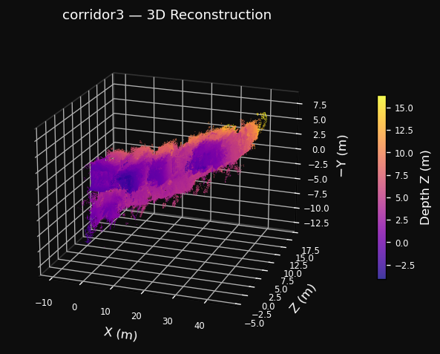
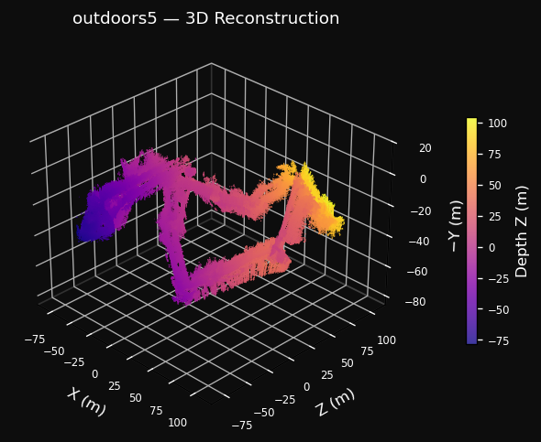
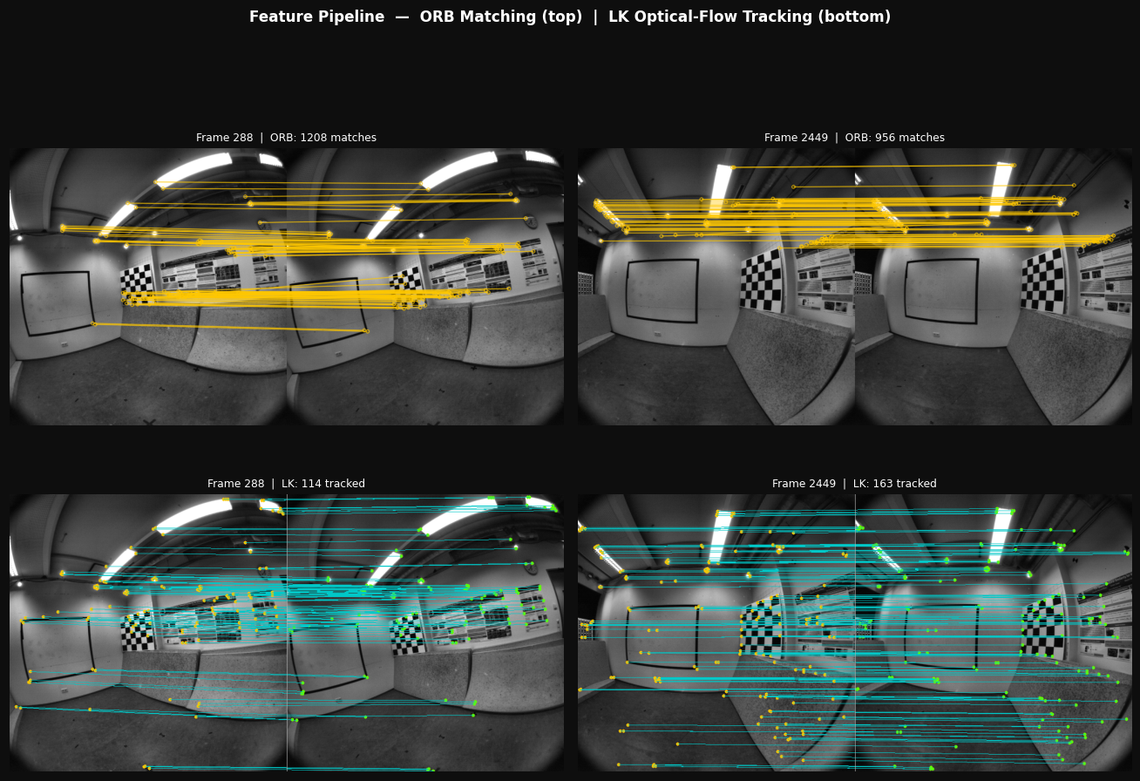
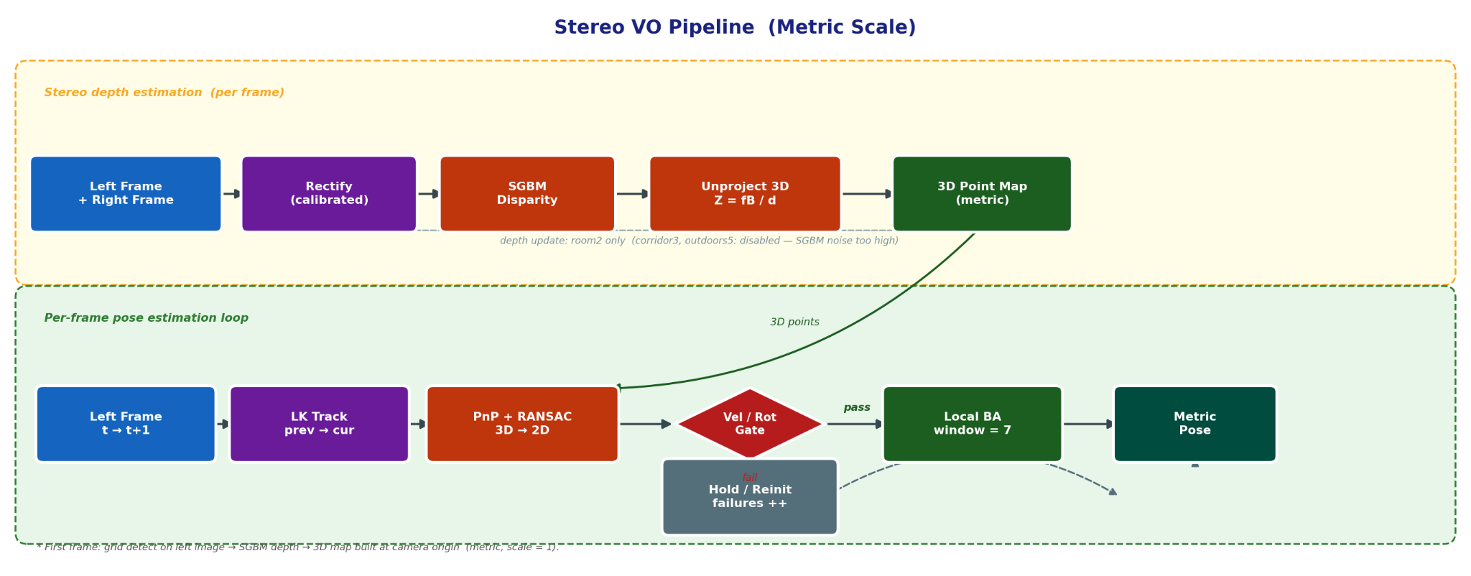

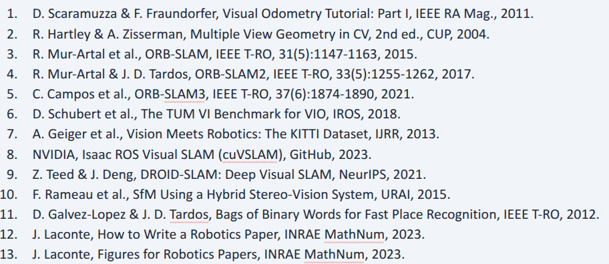
From Monocular to Metric Stereo Visual Odometry on the TUM VI Benchmark
Mayet Bekele Sharew · Li Xinning
Master's in Computer Vision and Robotics · Université de Bourgogne · Le Creusot, France
INTRODUCTION
QUANTITATIVE RESULTS
TRAJECTORY VISUALISATION
3D RECONSTRUCTION
• Visual Odometry (VO) estimates camera ego-motion from image sequences — no GPS, no wheel encoders required.
• Monocular VO: inherent scale ambiguity — translation is correct only up to an unknown scale factor.
• Stereo VO: known baseline B + disparity d → metric depth Z = fB / d.
• This work implements both pipelines from scratch in Python using only classical geometry (no deep learning).
Table 1 — room2 (full GT trajectory)
Metric | Mono | Stereo
ATE RMSE | 1.206 m | 0.436 m
Scale | 0.114 (9× under) | 1.000 (metric)
Failures | 5 / 2882 | 3 / 2882
Runtime | 110.0 fps | 37.9 fps
fB = 18.92 px·m · Z = 15 m → d ≈ 1.3 px disparity
→ Stereo achieves 64% lower ATE vs. monocular
SGBM disparity (left) and metric depth Z = fB/d (right) · room2 frame 288
Table 2 — corridor3 (partial GT)
HEADING DRIFT — OUTDOOR STEREO
DATASET — TUM VI BENCHMARK
Metric | Mono | Stereo
Endpoint Drift | 11.46 m | 5.75 m
Local ATE start | 0.735 m | 0.095 m
Local ATE end | 0.738 m | 0.216 m
Failures | 12 / 5802 | 14 / 5802
fB = 18.92 px·m · Z = 15 m → d ≈ 1.3 px disparity
σ_d = 0.5 px → σ_Z ≈ 6 m depth error per map point
PnP rotation bias per frame → heading drift over 17,747 frames
Same mechanism as corridor3, but 3× deeper & 3× longer sequence
Z_max = 20 m required; restricting to 5 m starves PnP tracker
Stereo maintains correct metric scale (≈927 m) throughout
Sequence | Frames | Duration | GT Coverage
room2 | 2,882 | 144 s | Full (89.8%)
corridor3 | 5,802 | 290 s | Start + End (20.6%)
outdoors5 | 17,747 | 887 s | Start + End (15.5%)
room2 | Blue = Mono · Red = Stereo · Green = GT
MONOCULAR PIPELINE
→ Stereo: 2.5× lower drift in confined corridor
COMPARISON VS. STATE OF THE ART (room2)
Feature Detection: ORB on 5×5 grid → 3,000 features max
Matching: BFMatcher kNN + Lowe ratio test (threshold 0.75)
Pose (init): Essential matrix via 5-point RANSAC
Scale Recovery: s = d₀ / z_N (depth-percentile method)
room2: d₀=2.0 m, N=25th pct → scale ≈ 0.111 (9× underscaled)
corridor3: d₀=5.0 m, N=50th pct
outdoors5: d₀=5.0 m, N=75th pct → scale ≈ 0.103
Tracking: LK optical flow → PnP + RANSAC → local BA (7-frame window)
Table 3 — outdoors5 (partial GT, large scale)
System | Sensors | Loop | ATE (m)
Ours (Stereo) | Stereo only | No | 0.436
ORB-SLAM2 | Stereo | Yes | ~0.05–0.10
ORB-SLAM3 | Stereo + IMU | Yes | ~0.01–0.03
Metric | Mono | Stereo
Endpoint Drift | 15.90 m* | 32.51 m
Path length | 455.8 m | 926.7 m (metric)
Local ATE start | 0.661 m | 0.343 m
Failures | 2 / 17747 | 12 / 17747
CONCLUSIONS
✓ Stereo outperforms mono on 2 / 3 sequences:
room2 — 64% ATE reduction · corridor3 — 2.5× lower drift
✗ Outdoors5: heading drift from noisy disparity at 5–20 m feature depth
✓ CLAHE critical for indoor robustness (83 → 14 failures in corridor3)
✗ CLAHE harmful for outdoor stereo (sky / foliage over-enhancement)
✓ RANSAC inlier ratio > 0.975 across all sequences (dynamic robustness)
→ Future: loop closure (DBoW2), IMU fusion, wider-baseline hardware
STEREO PIPELINE
* Mono path ×10 underscaled — drift comparison misleading. Stereo drift: heading error from noisy disparity at 5–20 m feature depth.
corridor3 | Blue = Mono · Red = Stereo · Green = GT
Rectification: fisheye undistort → stereo rectify
Depth: StereoSGBM → Z = fB / d, fB = 18.92 px·m
Depth update disabled for corridor3 / outdoors5
(Z > 5 m → SGBM noise σ_Z ≈ 6 m — biases PnP rotation)
Tracking: same LK + PnP + BA pipeline as monocular
CLAHE ILLUMINATION ABLATION
Seq | Pipeline | CLAHE | Fails | ATE / Drift
room2 | Stereo | ON (prod) | 3 | 0.436 m
room2 | Stereo | OFF (abl) | 18 | 0.788 m
corridor3 | Stereo | ON (prod) | 14 | 5.75 m
corridor3 | Stereo | OFF (abl) | 83 | 11.28 m
outdoors5 | Stereo | OFF (prod) | 12 | 32.51 m
outdoors5 | Stereo | ON (abl) | 13 | 201.08 m
CLAHE ILLUMINATION ABLATION
METRIC 3D POINT CLOUDS
PIPELINE ARCHITECTURE
Accumulated from up to 800 keyframes · Statistical Outlier Removal (SOR) · ~1M points per sequence
RANSAC inlier ratio r = n_inliers / n_tracked per frame.
Mean r > 0.975 confirms static-scene model holds.
DYNAMIC SCENE SENSITIVITY
Sequence | Pipeline | Mean r | r < 0.70 | r < 0.50
room2 | Mono | 0.982 | 0.2% | 0.1%
room2 | Stereo | 0.978 | 0.2% | 0.1%
corridor3 | Mono | 0.984 | 0.2% | 0.2%
corridor3 | Stereo | 0.977 | 0.3% | 0.3%
outdoors5 | Mono | 0.996 | 0.0% | 0.0%
outdoors5 | Stereo | 0.987 | 0.2% | 0.1%
outdoors5 | Blue = Mono · Red = Stereo · Green = GT
room2 (~5m room)
corridor3 (~45m)
outdoors5 (~927m)
FEATURE TRACKING SAMPLES
SOR cleaning: room2 2,562K→2,347K pts (8.4% removed) · corridor3 2,220K→2,183K pts (1.7%) · outdoors5 1,769K→1,704K pts (3.8%)
RPE ANALYSIS (room2)
Dynamic objects (pedestrians, cyclists) remain sparse vs ~3000 background features. RANSAC @ 99.9% confidence rejects them effectively.
Metric | Mono | Stereo | Note
RPE trans δ=1 | 0.106 m/frame | 0.179 m/frame | per-frame error
RPE trans 100m | N/A* | 1.005 m (885 seg) | 100m sub-segments
RPE rot 60° | 32.35°/seg | 2.03°/seg | rotation error
TRACKING ROBUSTNESS
Sequence | Mono fail | Mono reloc | Stereo fail | Stereo reinit
room2 | 5 | e=0, vd=0 | 3 | 3
corridor3 | 12 | e=0, vd=0 | 14 | 14
outdoors5 | 2 | e=0, vd=0 | 12 | 12
Row 1: ORB descriptor matches. Row 2: LK optical flow tracking. (room2)
IMPLEMENTATION HIGHLIGHTS
• Python · OpenCV 4.13 · NumPy 2.x · SciPy — no GPU, no deep learning
• 92–110 fps mono (~4.6–5.5× real-time) · 38–48 fps stereo (~1.9–2.4×) on Intel i7
• np.random.seed(42) — fully reproducible results
• All outputs: trajectory TXT (TUM format) · PNG plots · PLY point clouds · evaluation CSV
Success rate: room2 mono 99.83% / stereo 99.90% · corridor3 99.79% / 99.74% · outdoors5 99.99% / 99.93%
GITHUB REPOSITORY References
FEATURE DETECTOR COMPARISON
COORDINATE SYSTEMS
Scan to view full results & README
KEY EQUATIONS
Detector | room2 ATE | Runtime | Decision
SIFT | ~1.18 m | ~8 fps | ✗ Rejected
ORB | 1.206 m | ~50 fps | ✓ Selected
GT World Frame
Z ↑ (up)
|
└─── X (floor)
/
Y (floor)
X: right Y: forward Z: up
Floor motion: X–Y plane
VO Camera Frame
Z (forward, optical)
/
└──── X (right)
|
↓ Y (down)
X: right Y: down Z: forward
Floor motion: X–Z plane
Stereo depth: Z = fB / d
Mono scale: s = d₀ / zₙ
WHY LK OVER DESCRIPTOR MATCHING?
σ₂ noise: σ_Z = Z² · σ_d / fB
• Sub-pixel accuracy — continuous optical-flow update vs discrete keypoint match
• No re-detection overhead — tracks existing corners frame-to-frame
• ~3× faster at equal feature count (~50 fps vs ~17 fps for SIFT matching)
• Empirical: descriptor matching → +38–93% higher drift across all sequences
ATE RMSE: √( 1/N · Σᵢ ‖Tᵢ ⊖ Ţᵢ‖² )
github.com/mayet16/Stereo_Visual_Odometry
Contact: mayetbekele22@gmail.com | Université de Bourgogne · VIBOT Program · 2026

